Slide 1

Multiple features
Linear Regression with multiple variables
Machine Learning

Slide 2


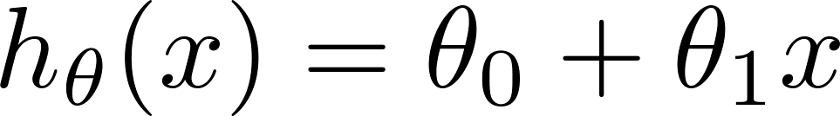
Recall linear regression with one variable
Size (feet²) | Price ($1000)
2104 | 460
1416 | 232
1534 | 315
852 | 178
… | …

Slide 3
Linear regression with multiple variables (features)
Size (feet²) | Number of bedrooms | Number of floors | Age of home (years) | Price ($1000)
2104 | 5 | 1 | 45 | 460
1416 | 3 | 2 | 40 | 232
1534 | 3 | 2 | 30 | 315
852 | 2 | 1 | 36 | 178
… | … | … | … | …

Slide 4



Multiple features (variables).
Size (feet²) | Number of bedrooms | Number of floors | Age of home (years) | Price ($1000)
2104 | 5 | 1 | 45 | 460
1416 | 3 | 2 | 40 | 232
1534 | 3 | 2 | 30 | 315
852 | 2 | 1 | 36 | 178
… | … | … | … | …
Notation:
= number of features
= input (features) of training example.
= value of feature in training example.
= number of samples
Notes:
Pop-up Quiz

Slide 5
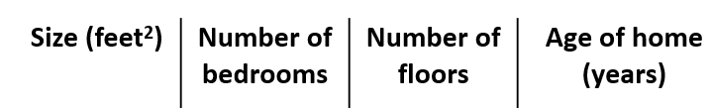
Hypothesis:
Previously:

Slide 6
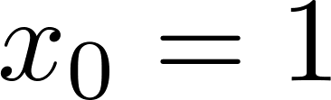
For convenience of notation, define .
Multivariate linear regression.

Slide 7
Gradient descent for multiple variables
Linear Regression with multiple variables
Machine Learning

Slide 8
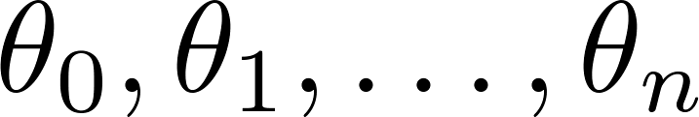
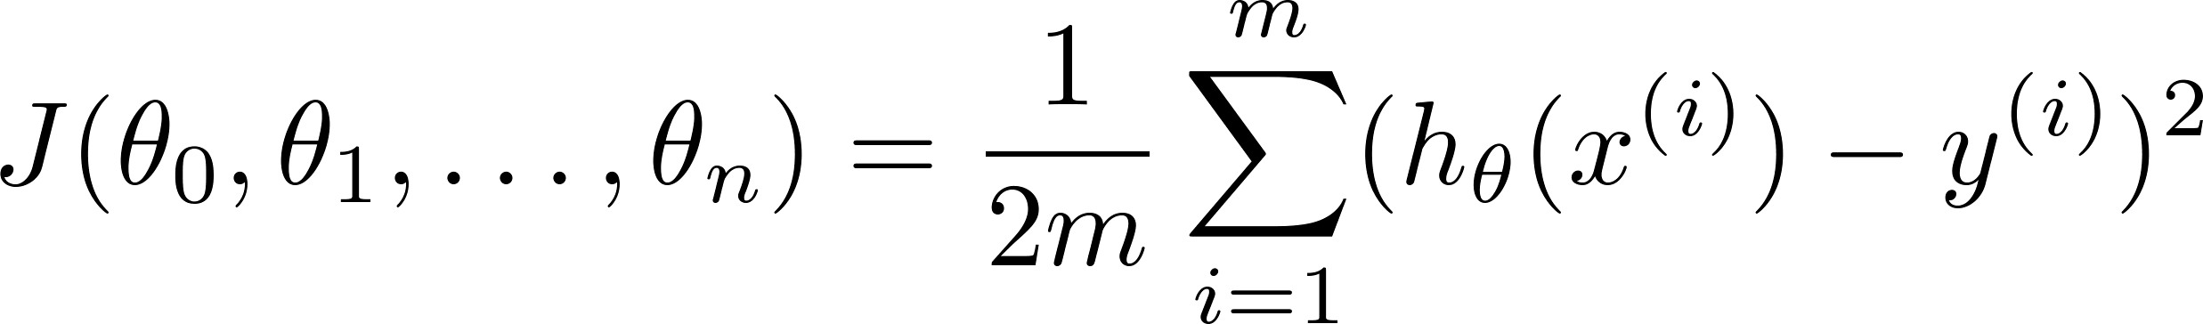

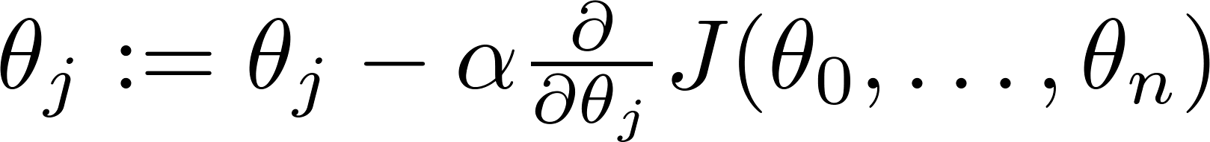

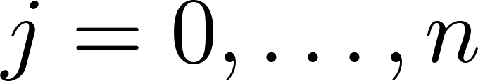
Hypothesis:
Parameters:
Cost function:
Gradient descent:
Repeat
(simultaneously update for every )

Slide 9

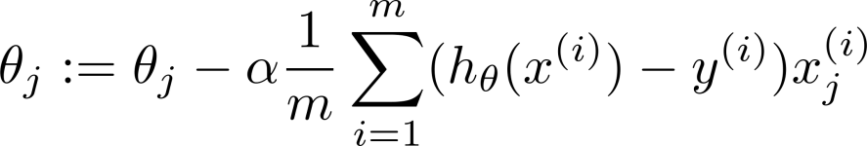
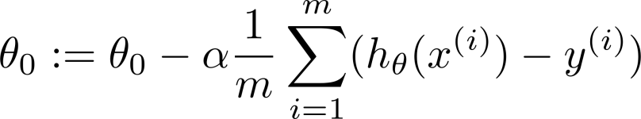



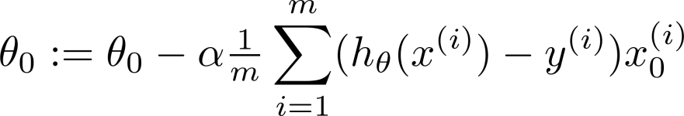
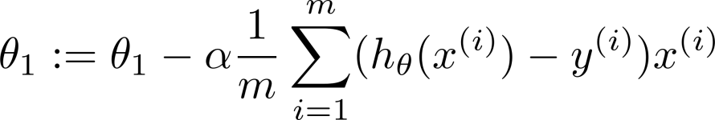
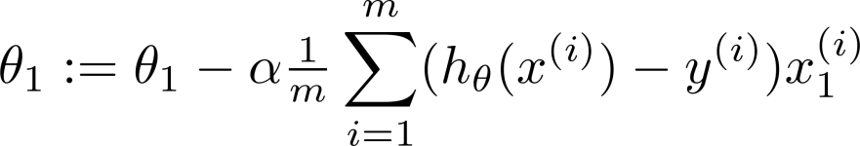

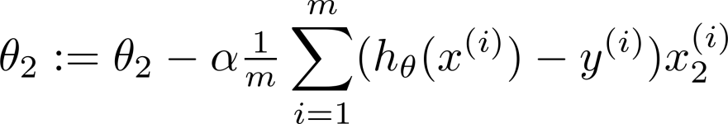
New algorithm :
Gradient Descent
Repeat
Previously (n=1):
Repeat
(simultaneously update for
)
=1
(simultaneously update )

Slide 10
Gradient descent in practice I: Feature Scaling
Linear Regression with multiple variables
Machine Learning

Slide 11
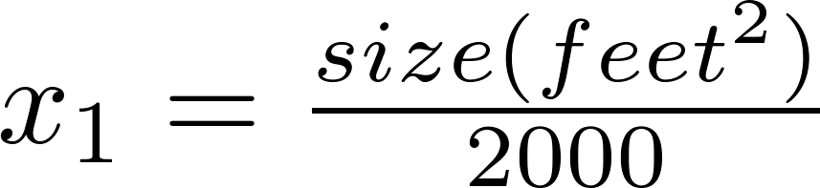


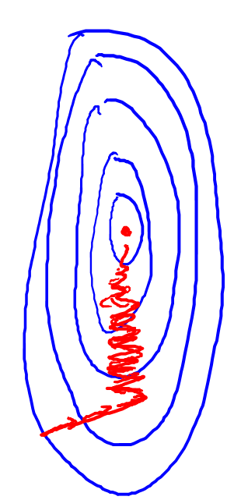
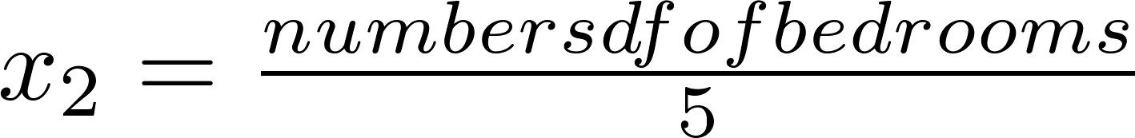
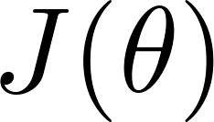

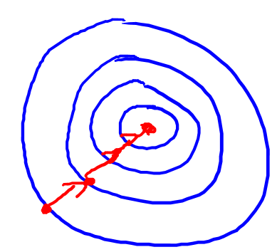

Feature Scaling
Idea: Make sure features are on a similar scale.
E.g. = size (0-2000 feet²)
= number of bedrooms (1-5)
size (feet²)
number of bedrooms

Slide 12
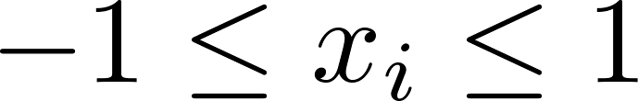
Feature Scaling
Get every feature into approximately a range.
e.g.

Slide 13



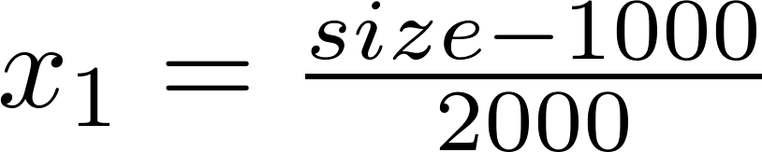
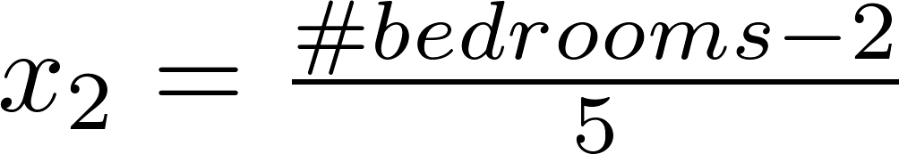
Mean normalization
Replace with to make features have approximately zero mean (Do not apply to ).
E.g.
I. Mean normalization
II. Z-score normalization

Slide 14
Gradient descent in practice II: Learning rate
Linear Regression with multiple variables
Machine Learning

Slide 15
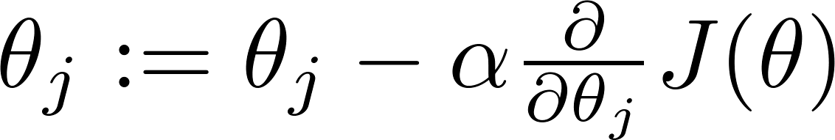

Gradient descent
“Debugging”: How to make sure gradient descent is working correctly.
How to choose learning rate .

Slide 16
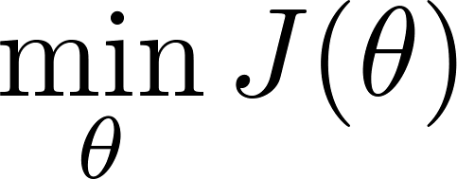
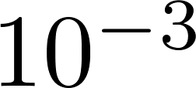
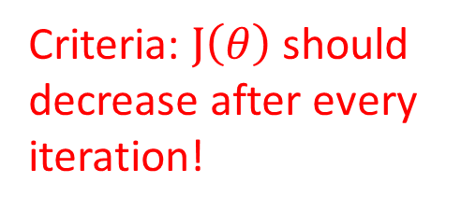
Making sure gradient descent is working correctly.
Example automatic convergence test:
Criteria: $J\left(θ\right)$should decrease after every iteration!
Declare convergence if decreases by less than in one iteration.
No. of iterations

Slide 17

Making sure gradient descent is working correctly.
Gradient descent not working.
Use smaller .
No. of iterations
No. of iterations
No. of iterations
For sufficiently small , should decrease on every iteration.
But if is too small, gradient descent can be slow to converge.

Slide 18
Summary:
If is too small: slow convergence.
If is too large: may not decrease on every iteration; may not converge.
To choose , try

Slide 19
Features and polynomial regression
Linear Regression with multiple variables
Machine Learning

Slide 20
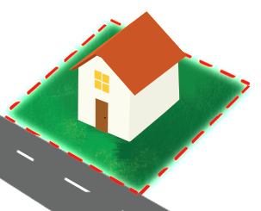
Housing prices prediction
Size = frontage*depth :

Slide 21
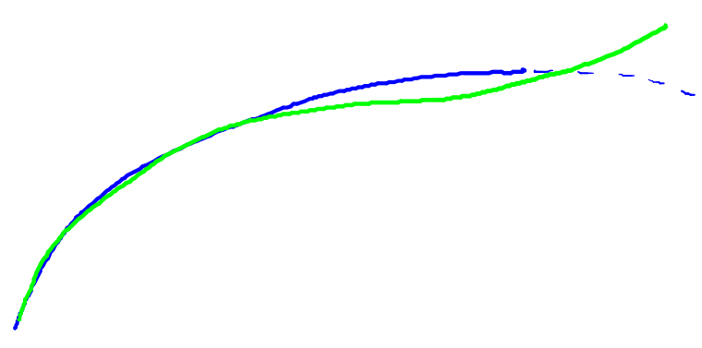
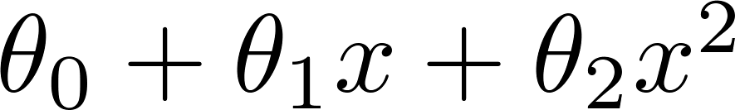
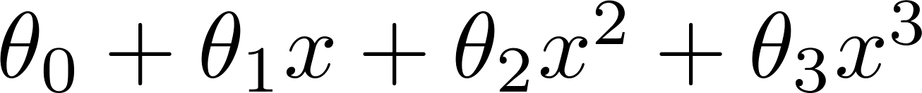
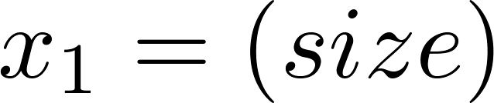
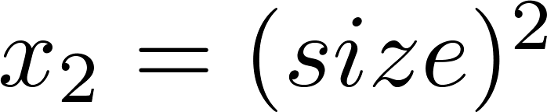
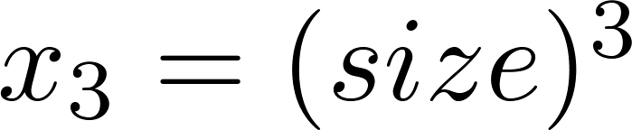
Polynomial regression
Price
(y)
Size (x)
Also need feature scaling

Slide 22
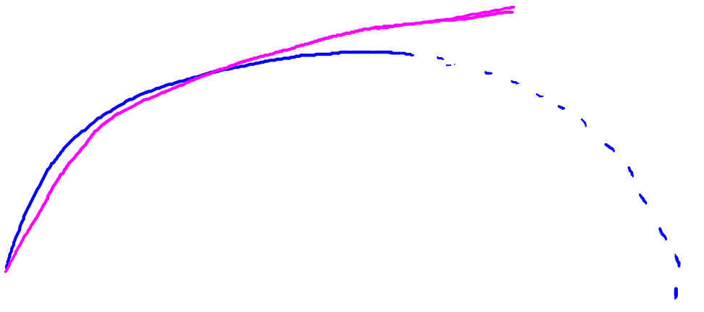
Choice of features
Price
(y)
Size (x)

Slide 23
Normal equation
Linear Regression with multiple variables
Machine Learning

Slide 24

Gradient Descent
Normal equation: Method to solve for
analytically.

Slide 25

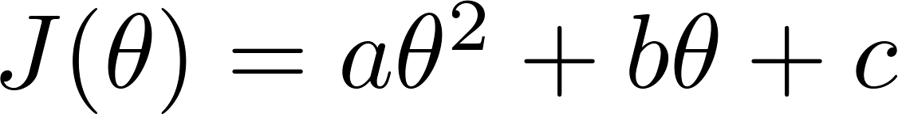

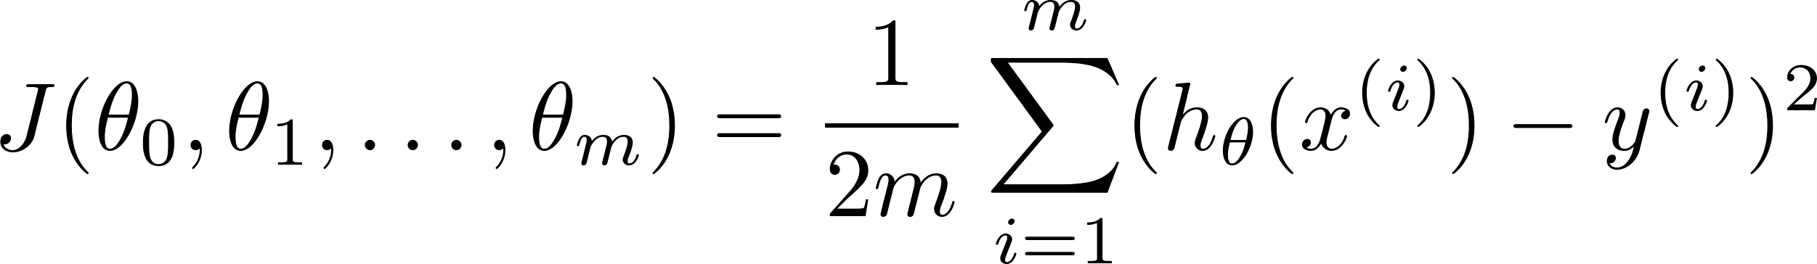
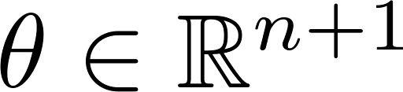
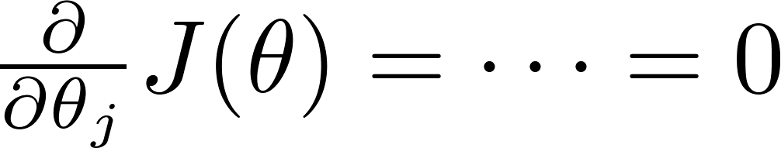

Intuition: If 1D
(for every )
Solve for

Slide 26






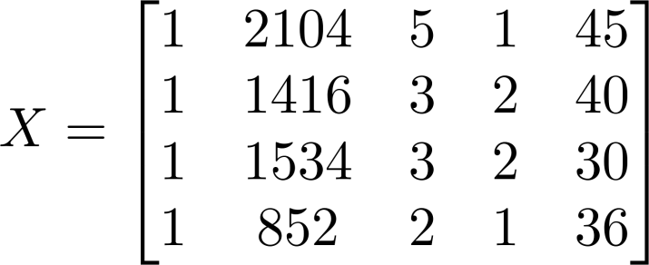
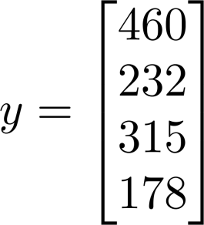
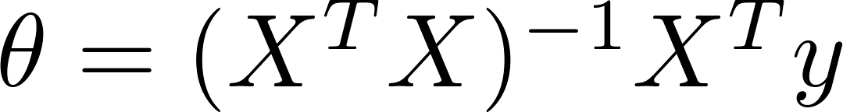
Examples:
 | Size (feet²) | Number of bedrooms | Number of floors | Age of home (years) | Price ($1000)
1 | 2104 | 5 | 1 | 45 | 460
1 | 1416 | 3 | 2 | 40 | 232
1 | 1534 | 3 | 2 | 30 | 315
1 | 852 | 2 | 1 | 36 | 178
Size (feet²) | Number of bedrooms | Number of floors | Age of home (years) | Price ($1000)
2104 | 5 | 1 | 45 | 460
1416 | 3 | 2 | 40 | 232
1534 | 3 | 2 | 30 | 315
852 | 2 | 1 | 36 | 178
Notes:
Pop-up Quiz

Slide 27

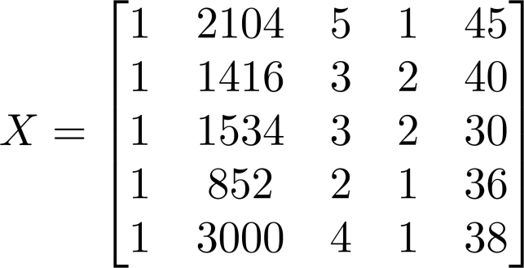
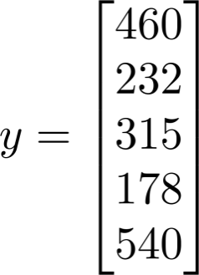
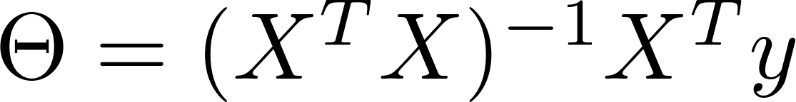
Examples:
 | Size (feet²) | Number of bedrooms | Number of floors | Age of home (years) | Price ($1000)
1 | 2104 | 5 | 1 | 45 | 460
1 | 1416 | 3 | 2 | 40 | 232
1 | 1534 | 3 | 2 | 30 | 315
1 | 852 | 2 | 1 | 36 | 178
1
Size (feet²) | Number of bedrooms | Number of floors | Age of home (years) | Price ($1000)
2104 | 5 | 1 | 45 | 460
1416 | 3 | 2 | 40 | 232
1534 | 3 | 2 | 30 | 315
852 | 2 | 1 | 36 | 178
3000 | 4 | 1 | 38 | 540
Notes:
Pop-up Quiz

Slide 28


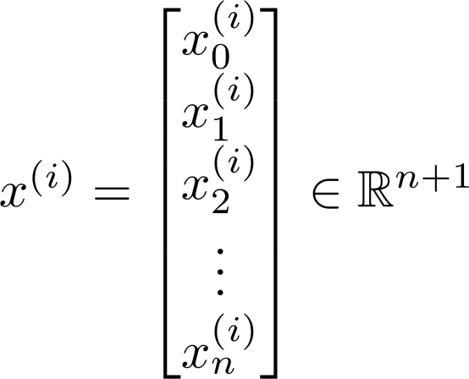
examples ; features.
Sample matrix:

Slide 29
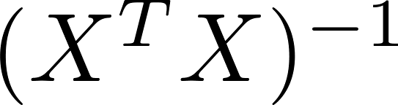

is inverse of matrix .
Matlab:
pinv(X’*X)*X’*y

Slide 30
training examples, features.
Gradient Descent
Normal Equation
Need to choose .
Needs many iterations.
No need to choose .
Don’t need to iterate.
Works well even when is large.
适用于各种类型的模型。
Need to compute
Slow if is very large.
只适用于线性模型，不适合逻辑回归等其他模型。

Slide 31
第2、3章 线性回归重点
单变量线性回归的假设函数、代价函数、优化目标、梯度下降对参数theta的更新（对参数进行同步更新）
多变量线性回归的假设函数、代价函数、优化目标、梯度下降对参数theta的更新
学习率的选择（过大或过小）对代价函数变化的影响
当使用多个特征建模时，为什么要进行特征缩放？
……

